Slide 1

Robbery Crime Prediction Using Twitter Sentiment and Demographics A New Methodological Study using Machine Learning
Jiaqi Tang
Advisor: Dr. John Hipp

Slide 2
Introduction
Motivation
Dataset
Methodology
Result
Future work
Limitation

Slide 3
Motivation
Methodological motivation:
Combine information technology and traditional statistics in social analysis
Theoretical motivation:
Emotions play significant roles in human decision-making
Crime prediction has attracted much attention
Traditional crime prediction cannot account for Social behavior in social media

Slide 4
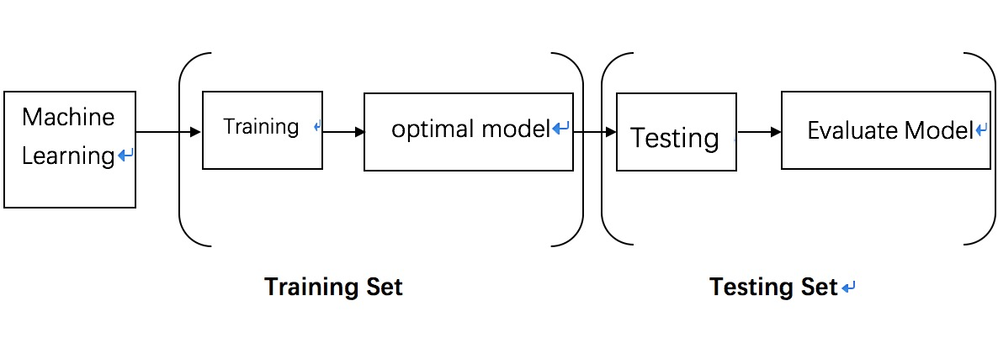
Machine Learning

Slide 5
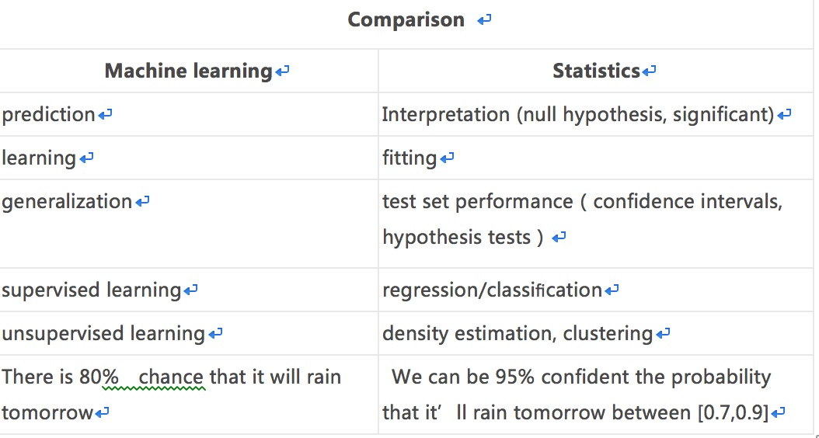
Traditional Statistics vs. Machine Learning

Slide 6
Research Questions
Can twitter mood predict future robbery crime?
What is the relationship between twitter sentiment and age distribution of the people who post these tweets?
Can twitter sentiment and age predict future crime occurrences?

Slide 7
Dataset
Table1. Descriptive Table of Twitter Sentiment Scores
Research Area : LA city
The counts of Robbery crime is 4,670 ( collected from LAPD)
The twitter data and crime data are from 05/11/2015 to 12/02/2015
The counts of twitter data is 738,334 , each tweet has user name, location and time
All of the data I collected is raw data (not survey data) and I created my own dataset

Slide 8
Methodology
Using streaming API to get twitter data by Python
Using sentiment analysis to get sentiment scores of each tweet
Using regression model and machine learning for creating predictive model for crime prediction

Slide 9
Sentiment analysis
Tweet
Remove
emoji and
URL
Tokenize
Machine Learning model for Classification
Separate Tweets to
different sentences
Classify tweets into
different sentiment scores

Slide 10
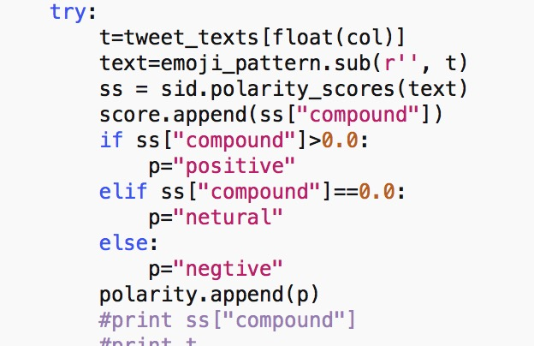
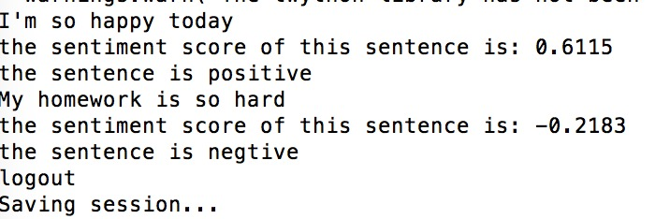
Examples for sentiment analysis

Slide 11
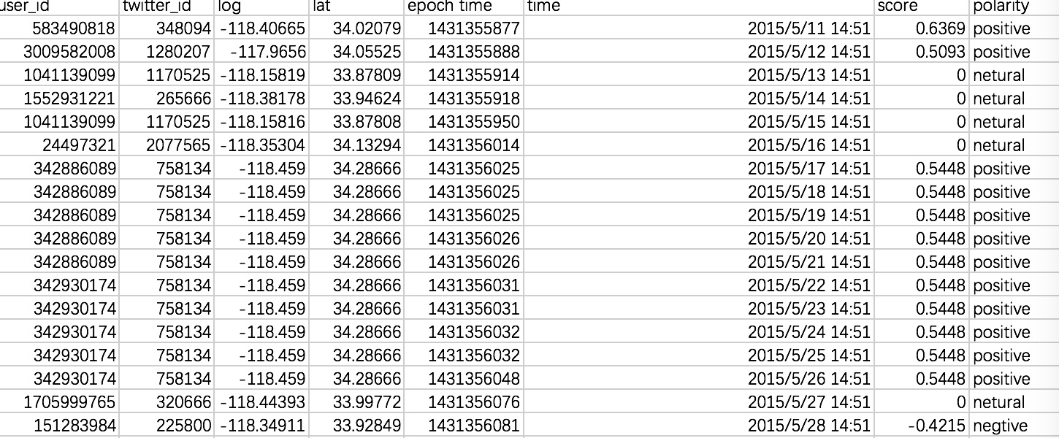

Slide 12
Twitter sentiment statistic
Table1. Descriptive Table of Twitter Sentiment Scores
Count | Mean | Std | Min | Max
738,334 | 0.145 | 0.369 | -0.993 | 0.992

Slide 13
Sentiment analysis for crime prediction
OLS Regression
Y= a+ β X+ u
For each day:
Y occurrences of robbery crime
X average sentiment scores

Slide 14
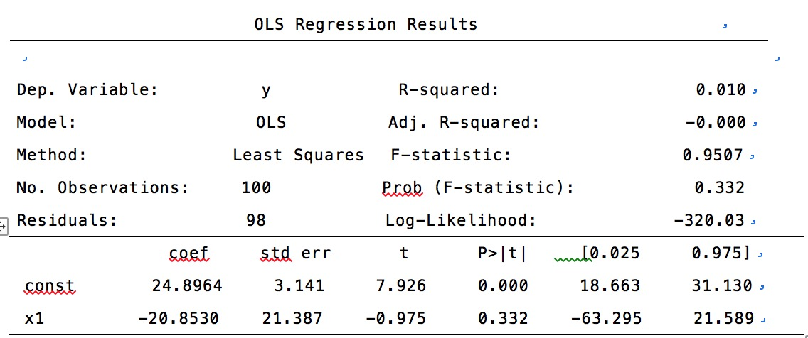
OLS Regression

Slide 15
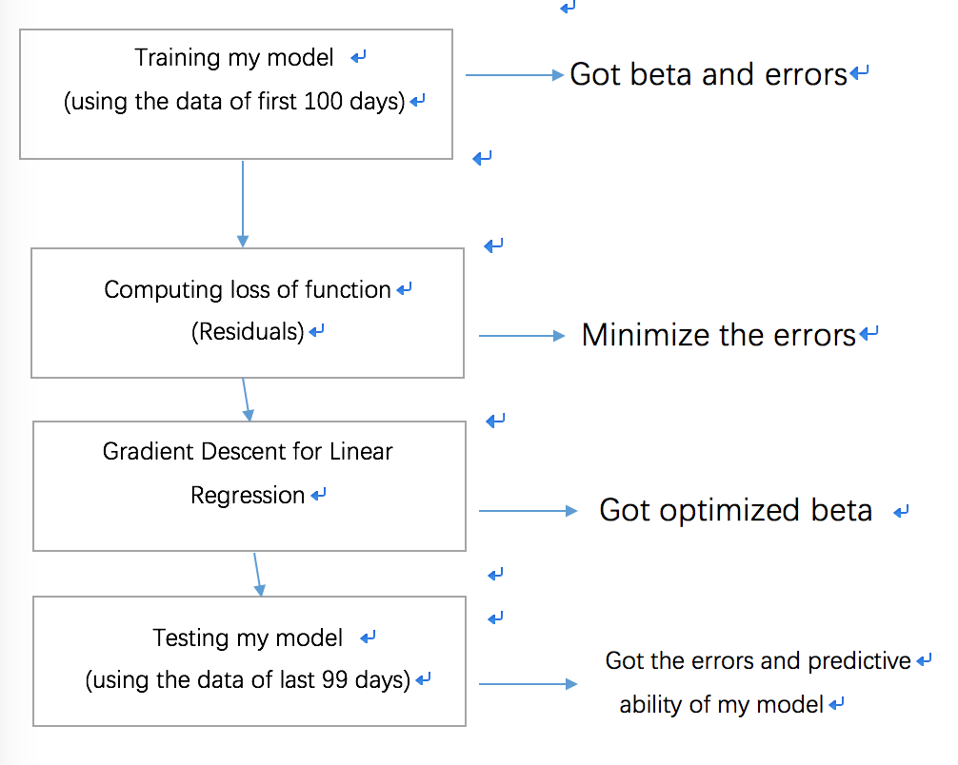
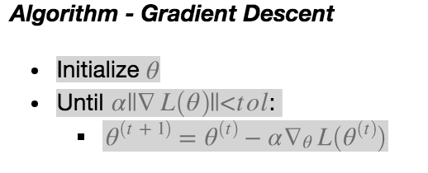
Machine Learning using OLS Regression

Slide 16
Machine Learning Result
1. Training set:
y= 24.89-20.85 X + u
Model : OLS regression model
Minimize Loss of Function(the residuals between expected value and observant value):
y=24.89 -19.69 X + u
2. Testing set:
The errors in this new model is 59.45 (Residuals)

Slide 18
Limitations
Twitter data limitation, there is only 6 months twitter data in my project
Sentiment analysis limitation, the emoji was removed , the algorithm for emoji analysis should be created in future
Only used OLS model in this project

Slide 19
Future research
To attain larger dataset of twitter data
To use this method in different places for doing spatial temporal analysis
To use different models by machine learning for getting optimal model

